Slide 1
Inequalities

Slide 2
Inequalities
There are four inequality signs:
< > ≥ ≤
a < 4
f > 6
s ≤ 5
k ≥ 7
3 < g ≤ 6
- a is less than 4
- f is greater than 6
- s is less than or equal to 5
- k is greater than or equal to 7
- g is greater than 3 and less than or equal to 6

Slide 3
Representing inequalities on a number line:
x > 2
-4 -3 -2 -1 0 1 2 3 4

Slide 4
Representing inequalities on a number line:
x < 1
-4 -3 -2 -1 0 1 2 3 4
If it is greater than or less than, the circle is not filled in

Slide 5
Representing inequalities on a number line:
x ≤ -2
-4 -3 -2 -1 0 1 2 3 4

Slide 6
Representing inequalities on a number line:
x ≥ -1
-4 -3 -2 -1 0 1 2 3 4
If it is greater than or equal to / less than or equal to, the circle is filled in. The way I remember it: more values are valid, more ink is needed to fill in the dot.

Slide 7
Representing inequalities on a number line:
-2 < x ≤ 4
-4 -3 -2 -1 0 1 2 3 4

Slide 8
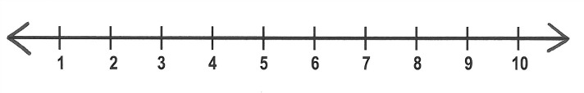
Match the inequalities with their diagram.
x < 8
5 ≤ x ≤ 8
x ≥ 5
x > 5
x ≤ 8

Slide 9
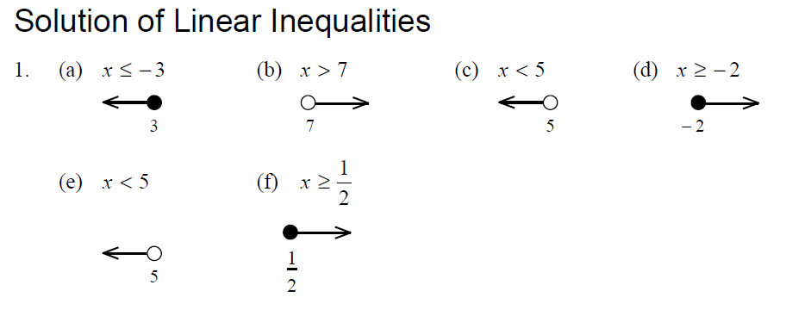
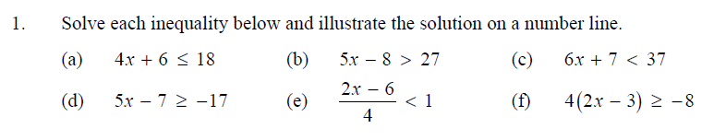
To Do

Slide 10
To Do

Slide 11
Show these inequalities on a number line
1 ≤ x < 5
-3 ≥ x > -5
x < -2, x ≥ 4
1 < x <3
x ≤ 3, x > 1

Slide 12
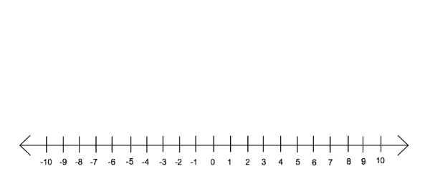
Show these inequalities on a number line

Slide 13
-2 < x ≤ 4
-4 -3 -2 -1 0 1 2 3 4
 | Inequality | Integer Values
1. | -2 < x ≤ 4
2. | 0 < r < 5
3. | -4 < s ≤ 2
4. | -5 ≤ p ≤ -2
5. | -4 ≤ h < 2

Slide 14
-2 < x ≤ 4
-4 -3 -2 -1 0 1 2 3 4
 | Inequality | Integer Values
1. | -2 < x ≤ 4
2. | 0 < r < 5
3. | -4 < s ≤ 2
4. | -5 ≤ p ≤ -2
5. | -4 ≤ h < 2
-1, 0, 1, 2, 3, 4

Slide 15
-2 < x ≤ 4
-4 -3 -2 -1 0 1 2 3 4
 | Inequality | Integer Values
1. | -2 < x ≤ 4
2. | 0 < r < 5
3. | -4 < s ≤ 2
4. | -5 ≤ p ≤ -2
5. | -4 ≤ h < 2
-1, 0, 1, 2, 3, 4
1, 2, 3, 4

Slide 16
-2 < x ≤ 4
-4 -3 -2 -1 0 1 2 3 4
 | Inequality | Integer Values
1. | -2 < x ≤ 4
2. | 0 < r < 5
3. | -4 < s ≤ 2
4. | -5 ≤ p ≤ -2
5. | -4 ≤ h < 2
-1, 0, 1, 2, 3, 4
1, 2, 3, 4
-3, -2, -1, 0, 1, 2

Slide 17
-2 < x ≤ 4
-4 -3 -2 -1 0 1 2 3 4
 | Inequality | Integer Values
1. | -2 < x ≤ 4
2. | 0 < r < 5
3. | -4 < s ≤ 2
4. | -5 ≤ p ≤ -2
5. | -4 ≤ h < 2
-1, 0, 1, 2, 3, 4
1, 2, 3, 4
-3, -2, -1, 0, 1, 2
-5, -4, -3, -2

Slide 18
-2 < x ≤ 4
-4 -3 -2 -1 0 1 2 3 4
 | Inequality | Integer Values
1. | -2 < x ≤ 4
2. | 0 < r < 5
3. | -4 < s ≤ 2
4. | -5 ≤ p ≤ -2
5. | -4 ≤ h < 2
-1, 0, 1, 2, 3, 4
1, 2, 3, 4
-3, -2, -1, 0, 1, 2
-5, -4, -3, -2
-4, -3, -2, -1, 0, 1

Slide 19
True or false?
x < 1
1

Slide 20
True or false?
x > 4
4

Slide 21
True or false?
x < 7
7

Slide 22
True or false?
x ≤ 12
12

Slide 23
True or false?
x ≤ 9
9

Slide 24
True or false?
5 ≤ x
5

Slide 25
True or false?
4 ≤ x < 7
4
7

Slide 26
True or false?
11 ≥ x > 5
5
11

Slide 27
Solving Inequalities

Slide 28
5p + 5 > 20

Slide 29
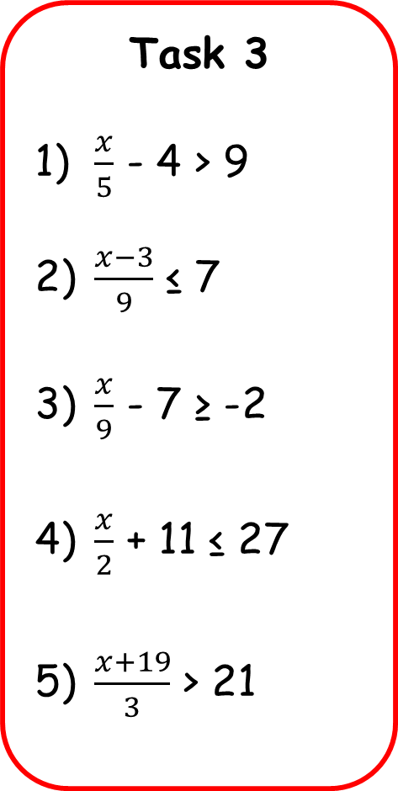
One Step Two Step With Fractions
Task 1
37 + a < 62
b - 10 ≤ -34
6c ≥ -84
d ÷ 3 < -8
e ≥ 21
Task 2
4a + 5 > -11
3b - 7 ≥ -22
4c + 3 < 27
9(g – 4) ≤ 54
2e + 6 ≤ 2
3

Slide 30

One Step Two Step With Fractions
Task 1
a < 25
b ≤ -24
c ≥ -14
d < -24
e ≥ 63
Task 2
a > -4
b ≥ -5
c < 6
g ≤ 10
e ≤ -2

Slide 31
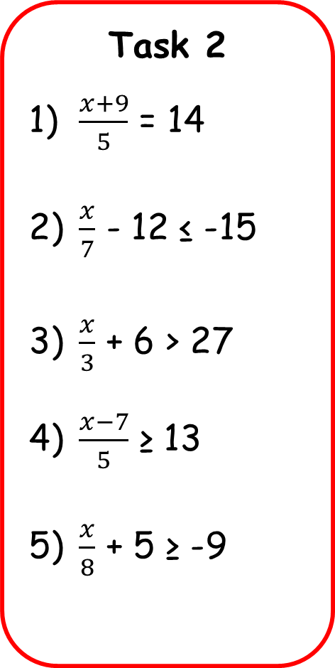
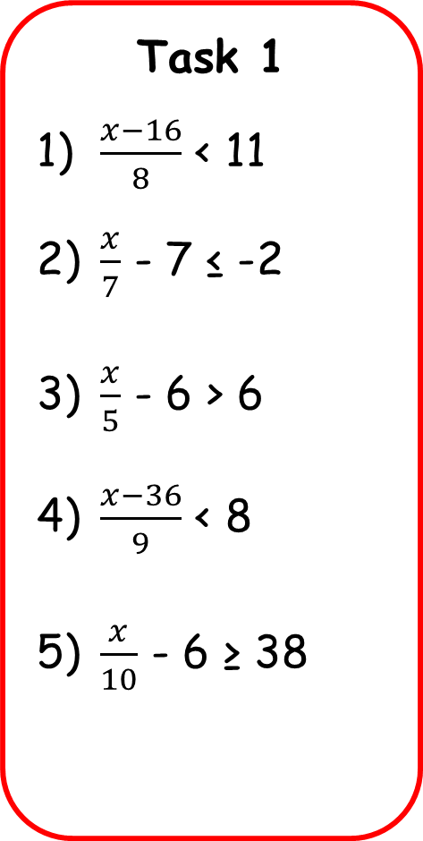
Outcome 5
I can solve single two step inequalities involving fractions
Task 1
$\frac{x−16}{8}$ < 11
$\frac{x}{7}$ - 7 ≤ -2
$\frac{x}{5}$ - 6 > 6
$\frac{x−36}{9}$ < 8
$\frac{x}{10}$ - 6 ≥ 38
Task 2
$\frac{x+9}{5}$ = 14
$\frac{x}{7}$ - 12 ≤ -15
$\frac{x}{3}$ + 6 > 27
$\frac{x−7}{5}$ ≥ 13
$\frac{x}{8}$ + 5 ≥ -9
Task 3
$\frac{x}{5}$ - 4 > 9
$\frac{x−3}{9}$ ≤ 7
$\frac{x}{9}$ - 7 ≥ -2
$\frac{x}{2}$ + 11 ≤ 27
$\frac{x+19}{3}$ > 21

Slide 32
Negative coefficients
-2x < 2
-x < 1

Slide 33
Negative coefficients
-2x < 2
-x < 1 (Divide by -1)
So is x < -1?

Slide 34
Negative coefficients
-2x < 2
-x < 1 (Divide by -1)
So is x < -1?
Try substituting any value less than -1 into the original equation
e.g. -2(-3) < 2
6 < 2

Slide 35
Negative coefficients
-2x < 2
-x < 1
So is x < -1?
Try substituting any value less than -1 into the original equation
e.g. -2(-3) < 2
6 < 2 Incorrect

Slide 36
Whenever you multiply or divide an inequality by a negative number, you must flip the inequality sign.

